Slide 1
Supervisor Review (week 9)
G3T3
Jeremy Ong
Darren Tay
Nabilah
Zhi hui
Shu Wen

Slide 2
Meeting Agenda
Update on Functionalities
Milestones
How we will flown/fly
Iteration Schedule
Critical Path
Task Metrics
Bug Metrics
Sample Images of Project
Ideas we have utilized
Libraries used
Learning Experience
Where we will go from here

Slide 3
Update on functionalities (Part 1)
T3
After Iter 3:
No Add/ Drop

Slide 4
Update on Functionalities (Part 2)
Required Functionalities: | Status:
Login | Testing on Openshift Done
2. Bootstrap | JSON, Debugging
3. Basic App Usage Report | Function 1
4. Top-k App Usage Report | Undone
5. Smartphone Overuse Report | Undone
6. Dual interfaces | Constantly in work
7. Loading location data | JSON, Debugging
8. Deletion of data | JSON, Debugging
9. Smartphone Usage Heatmap | Testing on Openshift Done
10. Social Activeness Report | Undone

Slide 5
Milestones
Week 13 [Iteration 6] : Project Submission
Week 7 [Iteration 3]: Technical Documents completed
Week 5 [Iteration 2] : Start Coding
Week 11[Iteration 5] : Application ready for UAT

Slide 6
How we have flown
ITERATION 1
28/8/2015 12/9/2015
ITERATION 2
12/9/2015
25/09/2015
ITERATION 3
25/09/2015
09/10/2015
Project Planning
Sequence Diagram
Use Case Diagram
ER Diagram
Bootstrap
Class Diagram
Sequence Diagram
Delete Location
Login/Logout
Basic App Report
Usage Heatmap
Sequence Diagram
Notes:
No white font

Slide 7
How we Will fly
ITERATION 4
09/10/2015
23/10/2015
ITERATION 5
23/10/2015
05/11/2015
ITERATION 6
05/11/2015
End
Basic App Report
Overuse Report
Top –K Report
Social Activeness
Test new ‘Test Cases’
Buffer
Debugging
Deploy to OpenShift
Seek loopholes
Final Presentation
Submission

Slide 8
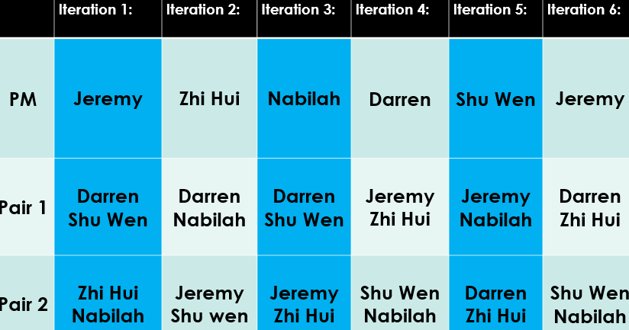
Iteration Schedule
Current Iteration!
Notes:
Rotation plan
wgich pm which milestone

Slide 9
Iteration schedule (Current Part 1)
Iteration 4 PM: Darren
Pair 1:
Jeremy Ong
Tan Zhi Hui
Pair 2:
Yee Shu Wen
Nabilah

Slide 10
Iteration Schedule (Current Part 2)
Pair 1:
Jeremy Ong
Tan Zhi Hui
Basic App Report (Week 1 of Iteration, 15/10 – 17/10)
Social Activeness (Week 2 of Iteration, 22/10 – 23/10)
Pair 2:
Yee Shu Wen
Nabilah
Smartphone overuse (Week 1 of Iteration, 12/10 – 13/10)
Top-K Report (Week 2 of Iteration, 17/10 – 23/10)

Slide 11
Critical path (Iteration 1) 28/08 – 12/09 (16 Days)
Start
Domain Diagram
1 Day
Use Case Diagram
1 Day
Buffer
1 Day
End
Build Project Schedule
2 Days
Sequence Diagram (Bootstrap)
3 Days
Consolidate Knowledge and Review Diagrams
1 Day
Entity-Relationship Diagram
2 Days
Buffer
1 Day
Key:
Critical Path
Non-Critical Path

Slide 12
Critical path (Iteration 2) 12/09 – 25/09 (15 Days)
End
Start
Sequence Diagram for Basic App Report
1 Day
Bootstrap
8 Days
Consolidate Knowledge and Review Diagrams
1 Day
Update Bootstrap Sequence Diagram
1 Day
Integrate Functionalities
1 Day
Sequence Diagram for Deletion Location Data
1 Day
Sequence Diagram Top-K
1 Day
Build Initial UI
1 Day
Buffer
4 Days
Sequence Diagram Smartphone Overuse
1 Day
Key:
Critical Path
Non-Critical Path

Slide 13
Critical path (Iteration 3) 25/09 – 09/10 (15 Days)
Basic App Report
6 Days
Buffer
1 Day
End
Sequence Diagram Login/Logout
1 Day
Sequence Diagram for Smartphone Usage
1 Day
Deploy to Openshift Login/Logout/Usage Heatmap
Integrating Functions
1 Day
Start
Consolidate all diagrams and check for matches.
Review Plans.
1 Day
Login/Logout
3 Days
Smartphone Usage Heatmap
3 Days
Bootstrap JSON
2 Days
Complete Bootstrap
6 Days
Delete Location Data
2 Days
Key:
Consolidate ER Diagram
1 Day
Update and consolidate Class Diagram
2 Days
Critical Path
Non-Critical Path

Slide 14
Critical path (Iteration 4) – Part 1 09/10 – 23/10 (15 Days)
Debugging Login/Logout/Usage Heatmap**
1 Day
Basic App Report
3 Days
Social Activeness Report
3 Days
Debugging of Bootstrap/Delete Location
2 Day
Buffer
2 Days
Start
Bootstrap JSON
1 Day
Testing Bootstrap/Delete Location on Openshift
1 Days
Buffer
4 Days
Testing on Openshift
Login/Logout
Review Plans**
1 Day
Integrating Functions
Deploy to Openshift (Basic App, Top-K, Social Active, Overuse)
1 Day
Debugging Bootstrap/Delete Location
2 Days
Deploy Bootstrap/Delete Location on Openshift
1 Day
Top-K Report
5 Days
Key:
Smartphone Overuse Report
3 Days
Critical Path
Non-Critical Path
*Testing in Iter 4 as overran time in Iter 3

Slide 15
Critical path (Iteration 4)- Part 2 09/10 – 23/10 (15 Days)
Testing Basic App/Overuse
1 Day
Buffer
1 Day
End
Integrating Functions
Deploy to Openshift (Basic App, Top-K, Social Active, Overuse)
1 Day
Debug Basic App
2 Days
Buffer
1 Day
Debug Overuse
1 Day
Key:
Critical Path
Non-Critical Path
*Testing in Iter 4 as overran time in Iter 3

Slide 16
Critical path (Iteration 5) 23/10 – 06/11 (15 Days)
End
Integrate Functionalities
Deploy to Openshift
1 Day
Debugging of Activeness
1 Day
Buffer
1 Day
UAT Test
1 Day
Start
Testing of Activeness/Top-K
1 Day
Buffer
7 Days
Further Testing
1 Day
Buffer
1 Day
Debugging of Top-K
2 Days
Final Testing
2 Days
Final Diagram Update
2 Days
Key:
Critical Path
Non-Critical Path

Slide 17
Critical path (Iteration 6) 06/11 – 20/11 (15 Days)
Debugging (Post-UAT)
4 Days
Final Deployment to Openshift
1 Day
Debugging on Openshift
1 Day
Start
End
Compilation of Report
2 Days
Presentation Preparation
7 Days
Key:
Critical Path
Non-Critical Path

Slide 18
Task metrics
Current:
Previous:
7.14%
83.3%
Time-Boxing
Time-Boxing
[Actual task/ estimated task]
3 tasks/ 42 tasks
[Actual task/ estimated task]
35 tasks/42 tasks

Slide 19
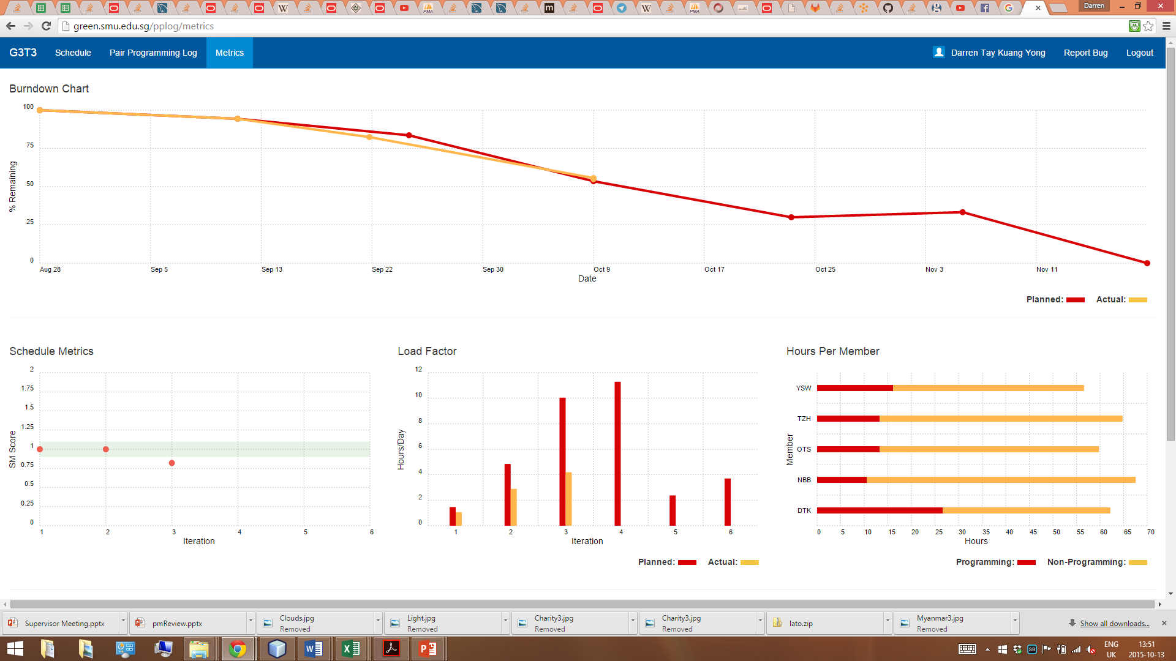
Task metrics
Burndown chart and discussion:
http://green.smu.edu.sg/pplog/metrics

Slide 20
Task metrics
Burndown chart and discussion:
http://green.smu.edu.sg/pplog/metrics

Slide 21
Task metrics
Burndown chart and discussion:
http://green.smu.edu.sg/pplog/metrics

Slide 22
Task metrics
Burndown chart and discussion:
http://green.smu.edu.sg/pplog/metrics

Slide 23
Task metrics
Burndown chart and discussion:
http://green.smu.edu.sg/pplog/metrics

Slide 24
Bug Metrics
Current:
Bug Metrics
11
IMPACT
Low 1Point | Not important. [typo, alignment etc.]
High 5 Points | System runs but some functions not working. Fix during planned debugging
Critical 10 Points | System down. Fix before continue
CRITICAL. Stop and Review.
Score = 1 x num(low)
+ 5 x num(high)
+10 x num(critical)

Slide 25

Bug Metrics
http://green.smu.edu.sg/is203/is203_g3t3/issues?assignee_id=&author_id=&label_name=&milestone_id=&scope=all&sort=created_desc&state=all

Slide 26
Bug Metrics
Issue | Function | Severity | Raw Score | Final Score | Description | Closed
1 | Bootstrap - Main Function | C | 10 | 0 | test | Y
2 | Heatmap | L | 1 | 0 | semanticplace in json output not sorted | Y
3 | JSONs | L | 1 | 0 | Jsons ordering unable to suit to wiki's requirements | Y
4 | Bootstrap | L | 1 | 0 | Bootstrap is unable to insert special characters | Y
5 | UI - Links | H | 5 | 0 | Broken links | Y
6 | OpenShift-Bootstrap | H | 5 | 0 | appusage table and locationusage table not found; causes system to crash when initializing bootstrap. table name is caps Sensitive. need to rename in IDE. | Y
7 | OpenShift-Heatmap | H | 5 | 0 | System crashes when heatmap request was sent. Possibly table name (appusage and locationusage) needs to be renamed (case sensitive) | Y
8 | Smartphone usage heatmap (via UI) | H | 5 | 0 | Crashes when input is: 6/04/2015 13:00:00 B1 | Y
9 | OpenShift-Initial Bootstrap | H | 5 | 5 | Bad Gateway:The proxy server received an invalid response from an upstream server. System unable to load a big zip file. (Might need to increase session time.) | N
10 | Openshift - Test case Fail | H | 5 | 0 | Error Messages for Location.csv and Location-Lookup don't tally | Y

Slide 27
Bug Metrics
11 | Openshift - Error messages not in sequence | L | 1 | 0 | The Error messages are not printed in the right order. Eg. Row 21 appears before row 10. | Y
12 | Bootstrap - Cannot load large data file (Data-zip 1) | C | 10 | 0 | The first data file of thousand entries cannot load finish before Java throws a Java Heap/Java out of memory error | Y
13 | Bootstrap - Cannot load large data file (Data-zip 3) | C | 10 | 0 | The third data file of a million entries cannot load finish before Java throws a Java Heap/Java out of memory error | Y
14 | Bootstrap - Duplicate entry rows are not returning | H | 5 | 0 | Duplicates in Bootstrap for the "most recent entry" have been solved, but then checking with the database for AddBatch are not displaying | Y
15 | Smartphone usage heatmap - misread instructions | C | 10 | 0 | Usage heatmap not supposed to take location data as "not there" after 5 minutes. | Y
16 | Bootstrap - Add Batch | H | 5 | 5 | Testing of Function | N
17 | Bootstrap - JSON Token | H | 5 | 0 | Bootstrap JSON does not load. Token is not passing through properly. Always returns error | Y
18 | Login - Database | H | 5 | 0 | After logging out, database refreshes | Y
19 | Login - Values | C | 10 | 0 | After start-up, the program does not allow entry because values not in database | Y
20 | JSONs | L | 1 | 0 | Error Messages passing to the UI cannot be resused for the JSON. Therefore, the controller is not that helpful | Y

Slide 28
Bug Metrics
21 | Delete Location - UI | L | 1 | 0 | Delete Location UI not displaying properly | Y
22 | Delete Location | L | 1 | 1 | Delete Location Test | N
23 | Delete Location - Logic | H | 5 | 0 | Delete Location (Choosing Options) don't delete the right choices | Y
24 | Bootstrap | H | 5 | 0 | Does not consider test case of no file uploaded | Y
25 | Delete Location - Values | H | 5 | 0 | Delete Location does not consider taking no values | Y
26 | Add Batch | H | 5 | 0 | Cannot read any number of files | Y
27 | Bootstrap | C | 10 | 0 | Fails Test case for App.csv | Y
28 | Bootstrap | C | 10 | 0 | Checking of date allows dates that have an inverted date format eg. DD/MM/YYYY instead of YYYY/MM/DD | Y
29 | Bootstrap | C | 10 | 0 | Categories are loaded in DAOs. Need to keep instantiating DAOs in reports. | Y

Slide 29
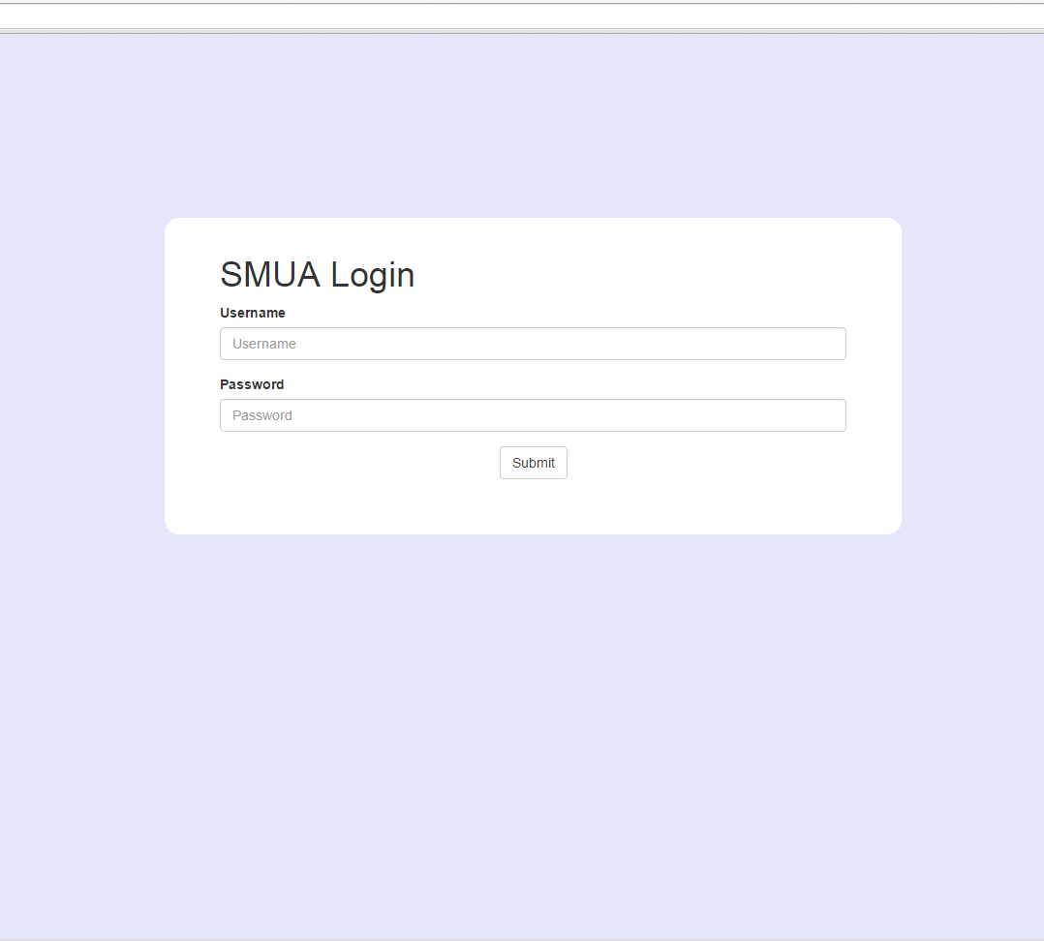
Sample Images of what we’ve done
*Note: Just some idea of the execution

Slide 30
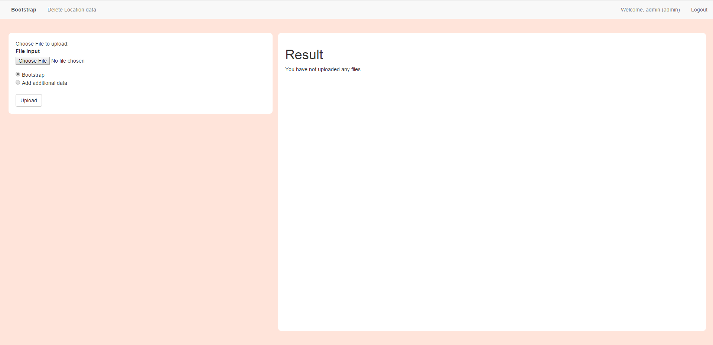
Sample Images of what we’ve done

Slide 31
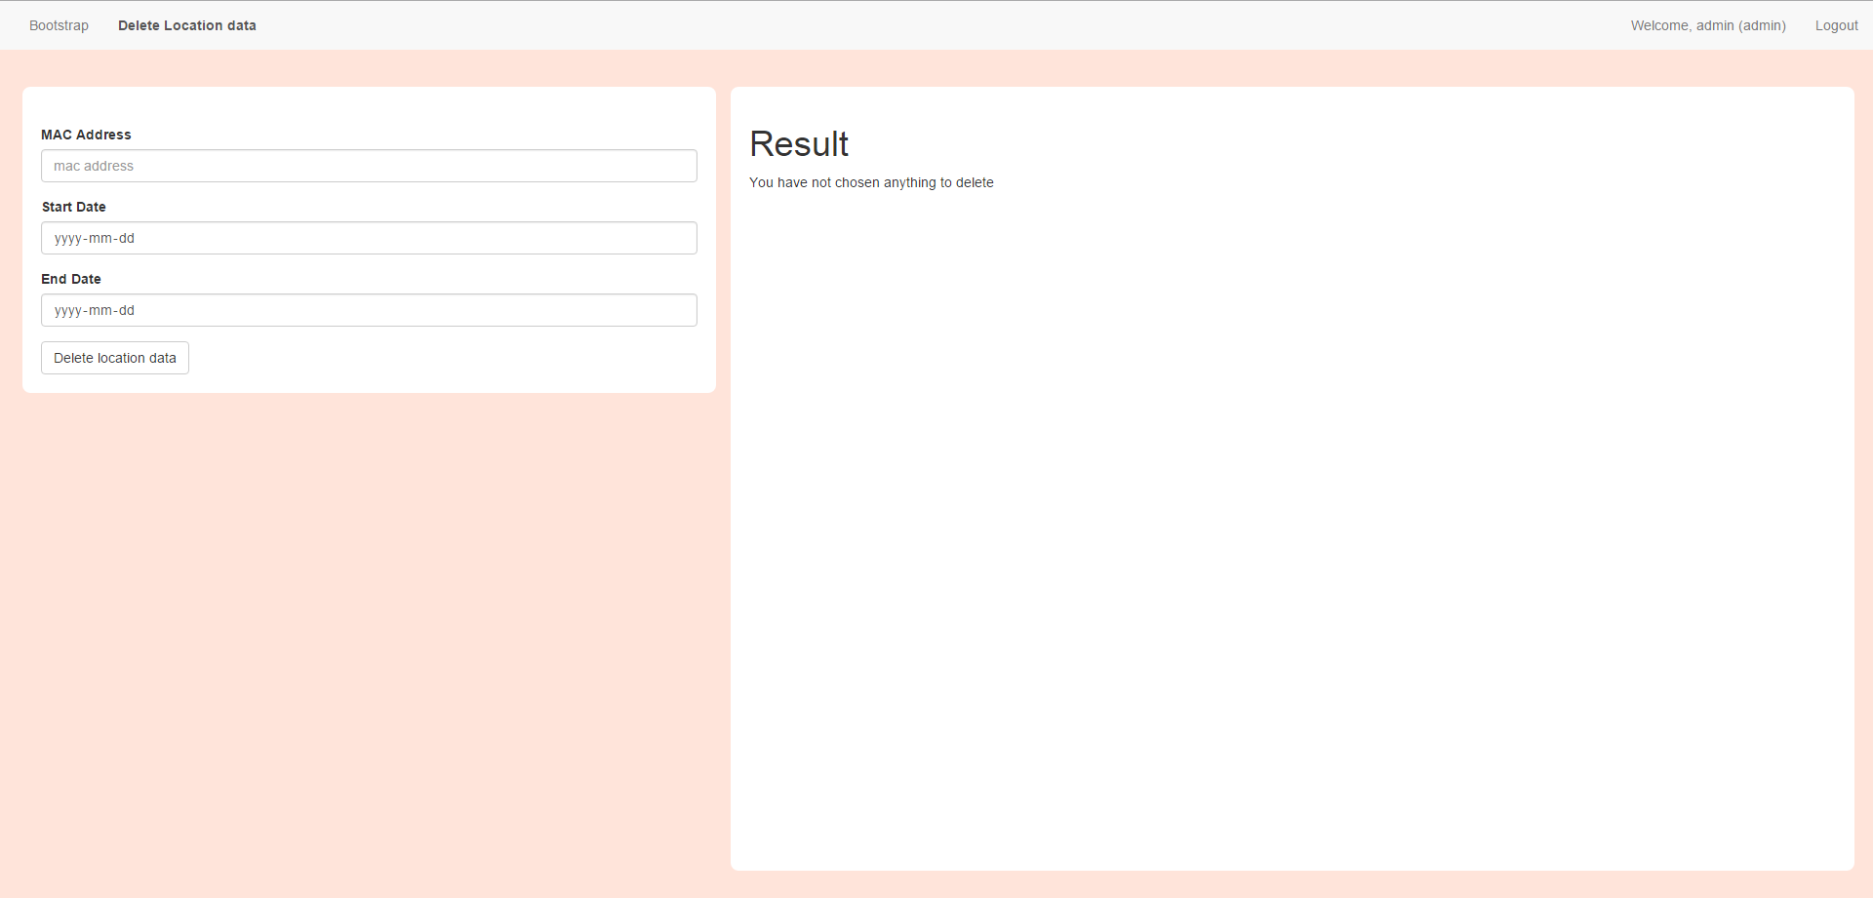
Sample Images of what we’ve done

Slide 32
Ideas we have utilized – Login/logout
Response.sendRedirect to Protect Pages
Session variable to log individuals
Separate Entities for Admin/Student
Separate pages for Admin/Student (Different Functions)
Logout: Sendredirect + removeAttribute
Form Action: Type = Password

Slide 33
Ideas we have utilized – Bootstrap
TreeMap:
Unique keys for duplicates and passing variables
Ties with JSON printing
Easier to retrieve from Home page
Queries
Checking with database for legit primary keys (appid, macadd, locationid)
On Duplicate Update
STR_TO_DATE
Addbatch, Executebatch, Executequery (int[] return)

Slide 34
Ideas we have utilized – Bootstrap
Zip File
ZipInputStream, Part, ZipEntry, one-by-one retrieval.
Ensures file input (UI side)
Servlet vs JSP
Higher level implementation of return variables (1 Passing system)
DoPost and DoGet (Difference)
Controllers (between JSON and Bootstrap UI)
Duplicate Checking at DAO level
Loading through DAOs

Slide 35
Ideas we have utilized – Bootstrap (UI)
Form Action Type = File (To take in file inputs)
Checks for TreeMap. If null, don’t print anything except nothing passed.
Printing from TreeMap (if present) and sorting by rows

Slide 36
Ideas we have utilized – Delete location
Add on to Bootstrap
For variables, follow Bootstrap, however, take in 3 variables (request.setAttributes)
Only returns if invalid variables OR success and rows deleted

Slide 37
Ideas we have utilized – Usage Heatmap
Get location based on floor from locationDAO
Get unique users on the floor based on query by joining tables
Ensures no duplicates with groupby
Use LocationUsage entity to log
Ignores 5 minutes update

Slide 38
Ideas we have utilized – Utility
Main checker whether methods work
parseString, parseDate, parseInt (Checks for Null)
Checkers (return Booleans)
checkDate
checkCategory/checkSchool
checkEmail (validity)
checkPassword

Slide 39

Libraries We have used
Bootstrap: OpenCSV
JSON: GSON
UI: Bootstrap

Slide 40
Learning experience
Bootstrap took much longer than expected
Usage Heatmap test cases still incomplete
Login fails two test casts
Latest not on Openshift
Foreseeable Problems for the future

Slide 41
Where we will go from here
ITERATION 4
09/10/2015
23/10/2015
ITERATION 5
23/10/2015
05/11/2015
ITERATION 6
05/11/2015
End
Basic App Report
Overuse Report
Top –K Report
Social Activeness
Test new ‘Test Cases’
Buffer
Debugging
Deploy to OpenShift
Seek loopholes
Final Presentation
Submission

Slide 42

THE END
Any questions?

